Slide 2

.NET AI
Phi Huynh
Microsoft MVP

Slide 3

Building LLM-powered apps with Semantic Kernel
The age of Copilots
Phi Huynh
Microsoft MVP

Slide 4
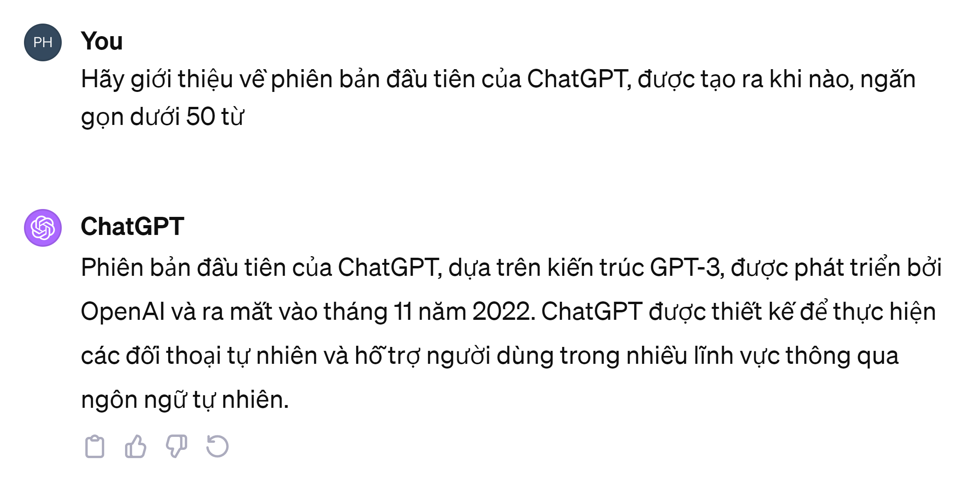


2022, November - a new legend was born

Slide 5
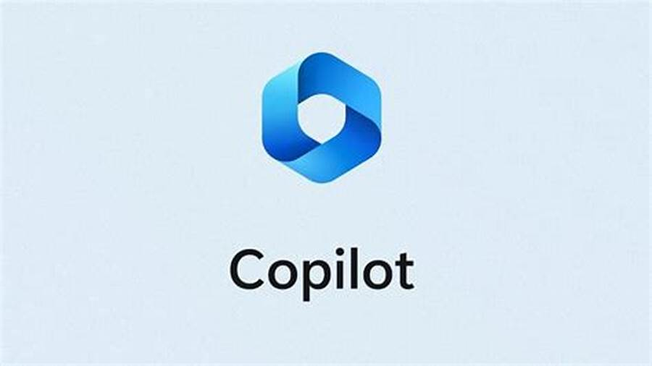




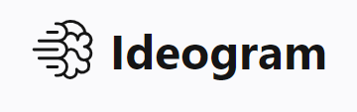








The rising waves of GenAI
WHAT GEN AI CAN DO?
Generate texts
Generate images, videos
Generate audios
Speech recognition, talk as a human
BUSINESS CASES
Architecture design
Copilot
Art
Marketing
Content writer
HR
Law-firm
The limitless is our imagination …
Leonardo AI

Slide 6
Popular models
These are the most popular models (both commercial & open-source)
Large language model / services
Image model
Commercial
Open-source
OpenAI / Azure OpenAI
DALL.E 2/3
Nvidia
StyleGAN
StabilityAI
Stable Diffusion
OpenAI / Azure OpenAI
gpt-35-turbo (4k/16k)
gpt-4, gpt-4v, gpt4-turbo
ada-002 (embedding)
Google
Google Bard, Palm
AWS
Amazon Nitro
Anthropic
Claude
Claude2
Meta
Llama 2
Databricks
Dolly 2
OpenLLMs
H2O
Finetune
LoRA/QLoRA
Audio model
OpenAI / Azure OpenAI
Whisper
TTS

Slide 7
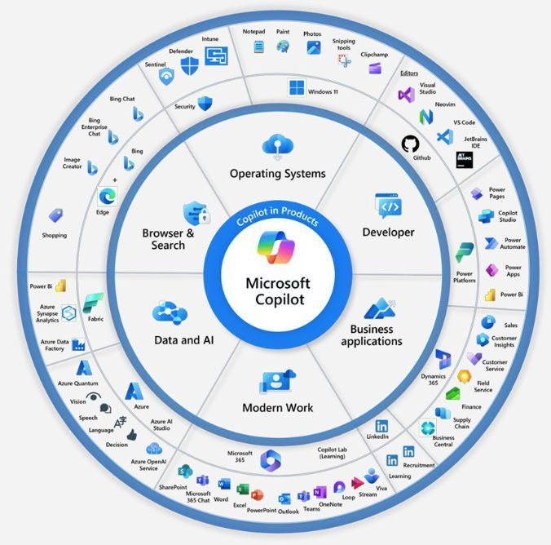
Microsoft GenAI ecosystem
Is Microsoft all-in AI?
Bing chat (https://copilot.microsoft.com)
Bing image
Azure OpenAI services
Microsoft Copilot (Word, Excel, PowerPoint, Teams, Sales, Azure, …)
GitHub Copilot, Copilot X
Azure AI Studio (preview)
Microsoft Copilot Studio (preview)
Frameworks and SDKs
Semantic Kernels
TeamsAI library

Slide 8
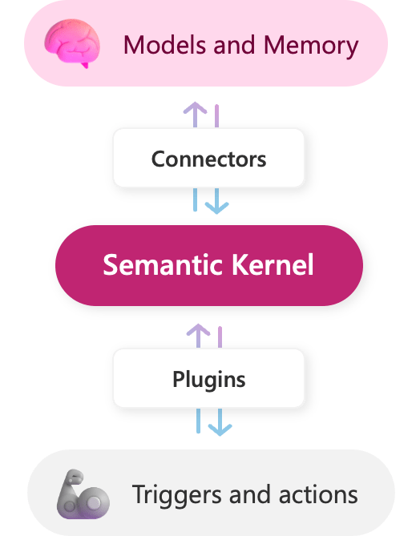
What is Semantic kernel?
An open-source SDK (support C#, Python, Java)
Easily combine with OpenAI, Azure OpenAI & Hugging Face
Easily to build GenAI apps

Slide 9
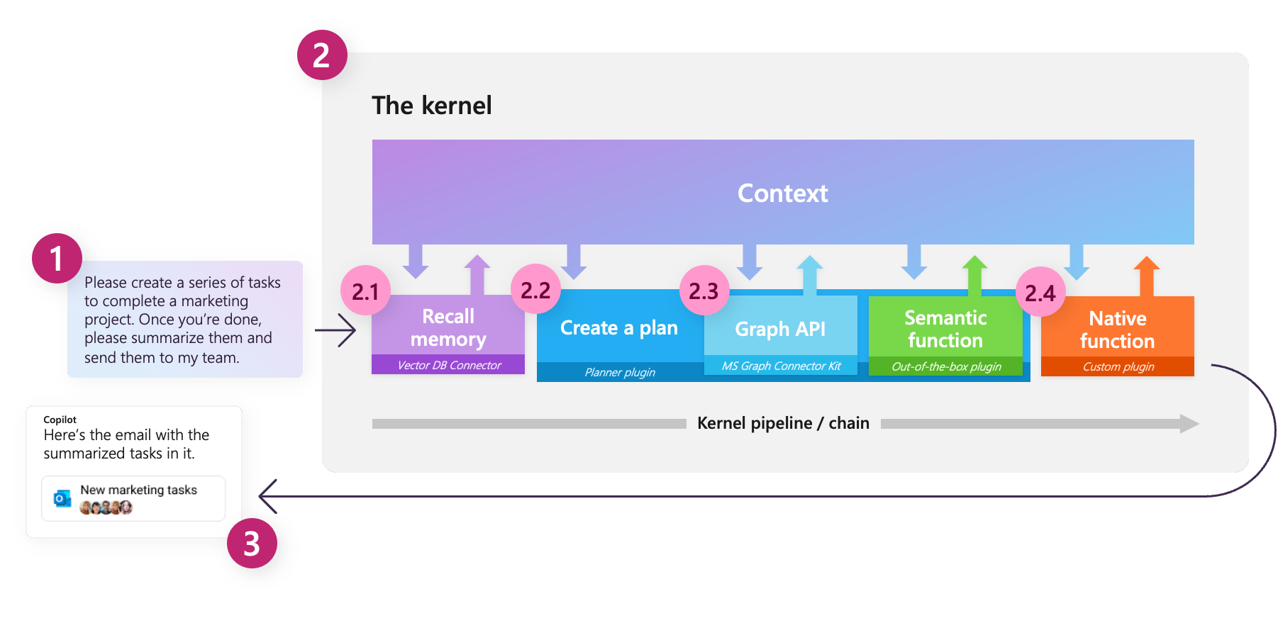
What exactly is the kernel?
Notes:
Orchestrate your AI with Semantic Kernel | Microsoft Learn

Slide 10
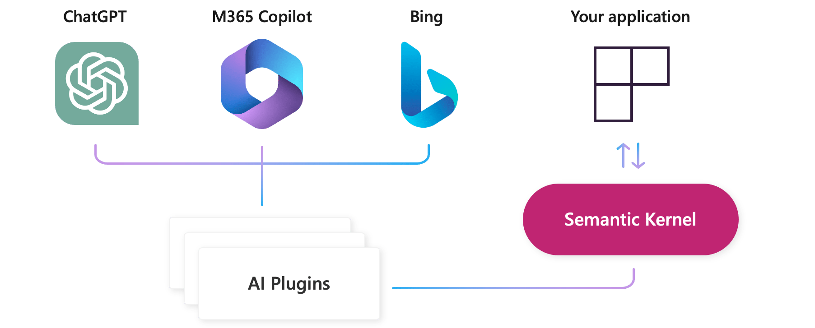
What is plugin?
Fundamental building block of Semantic Kernel
A set of semantic functions and native functions
Compatible with OpenAI plugin
OpenAI plugin specification
See more here

Slide 11
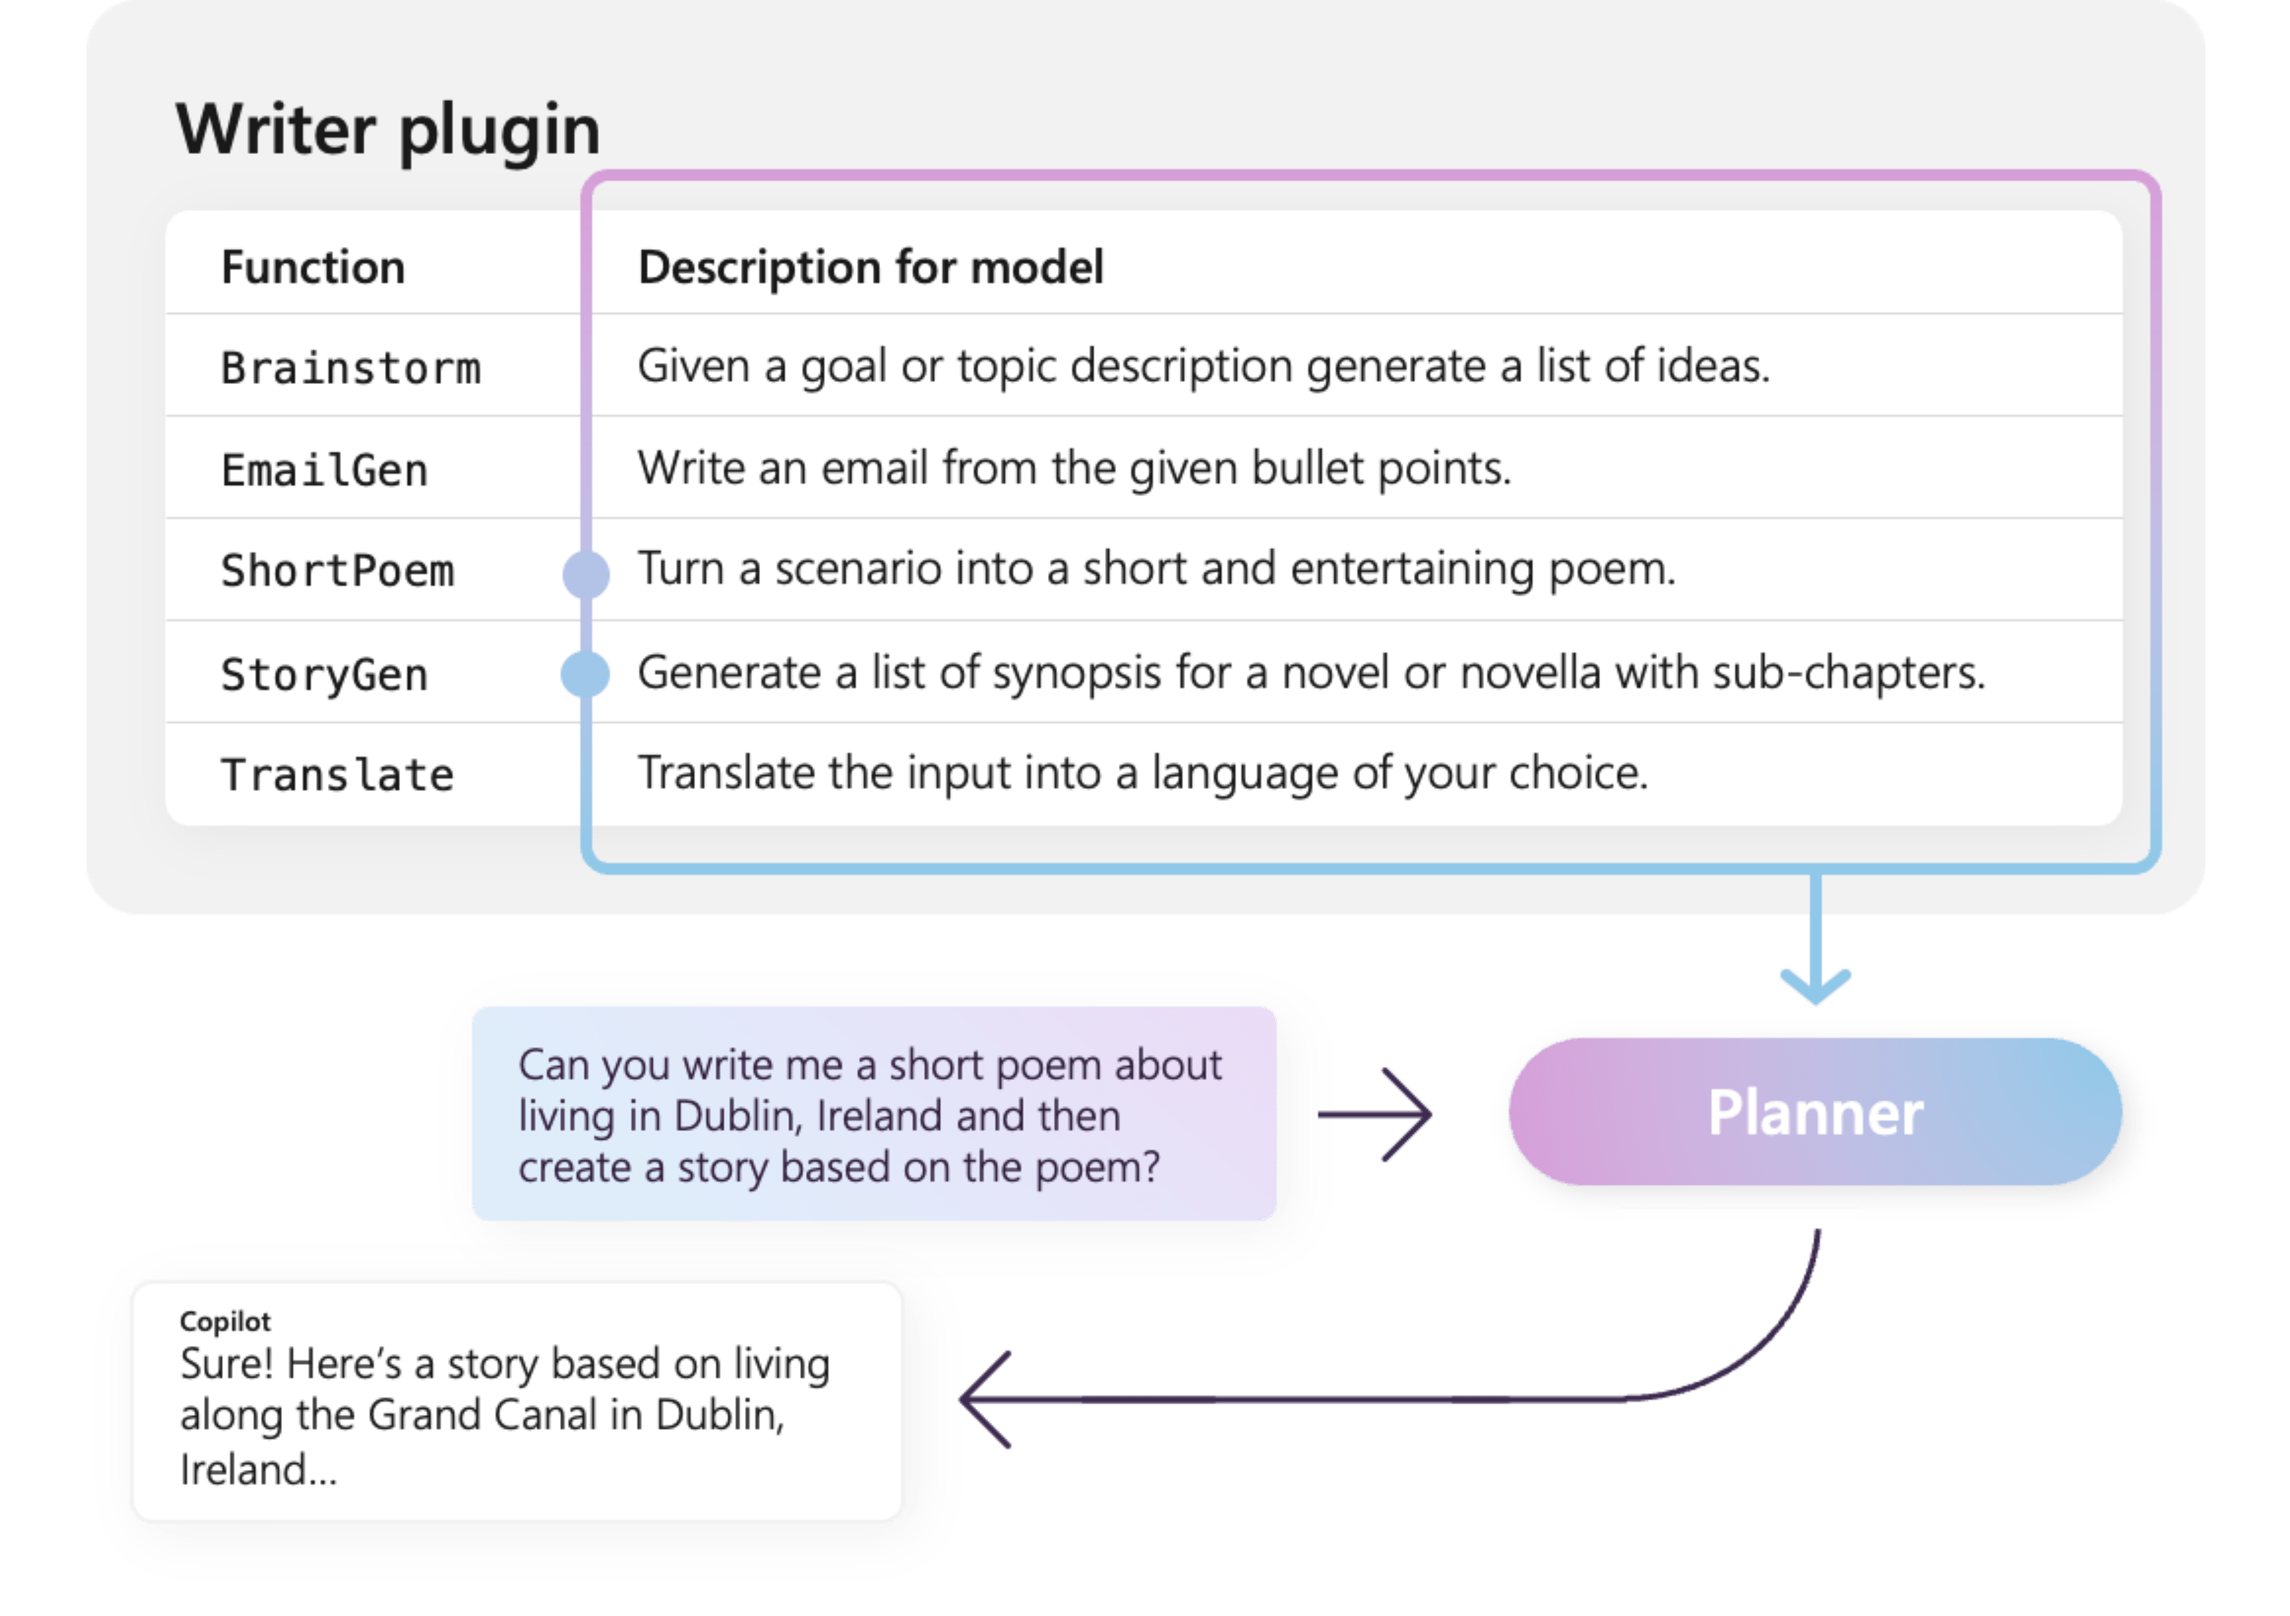
What is plugin?

Slide 12
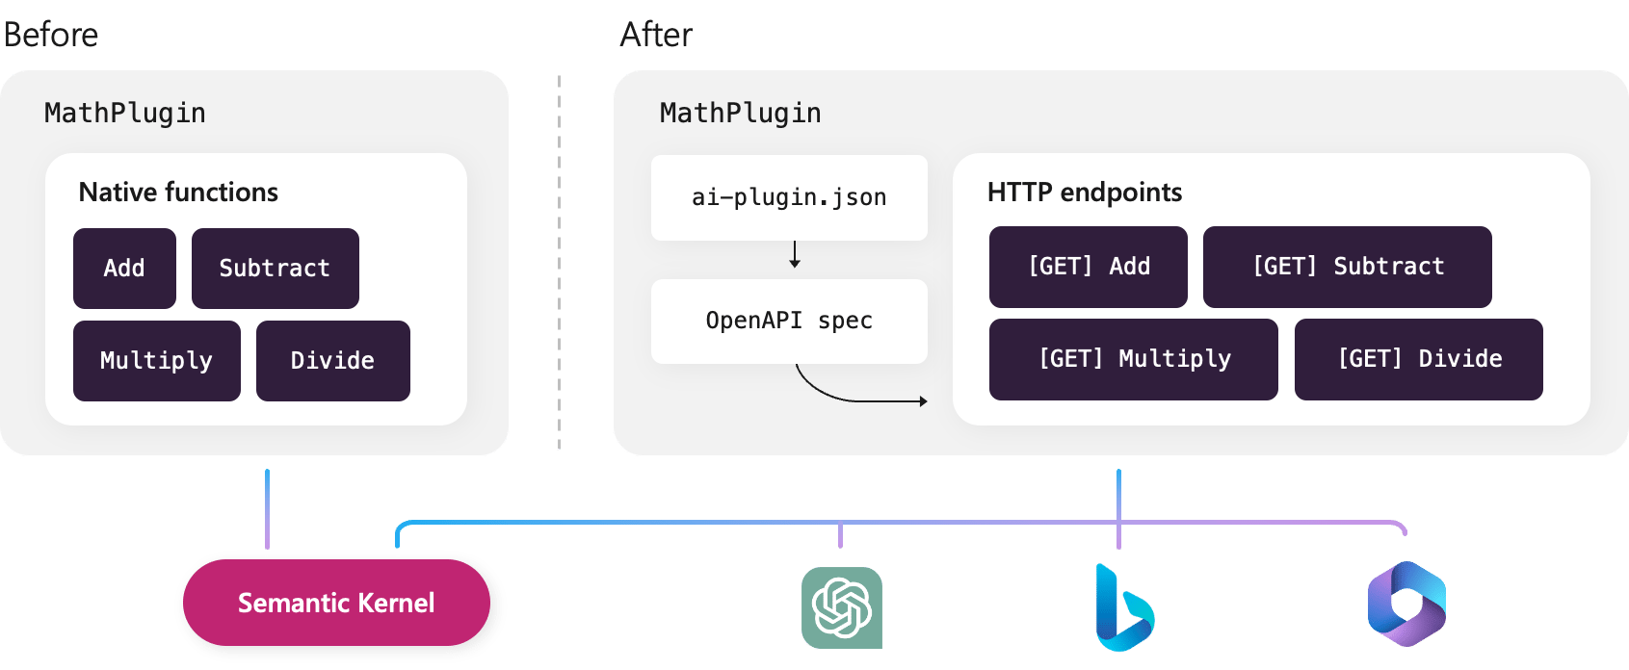
Import / export to ChatGPT plugins

Slide 13
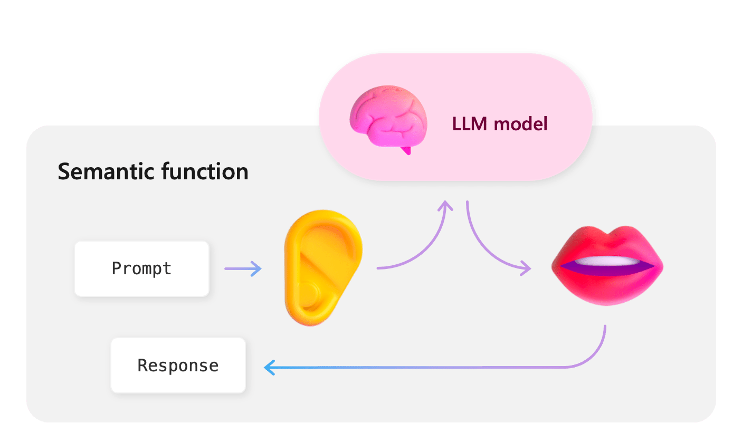
Semantic functions

Slide 14
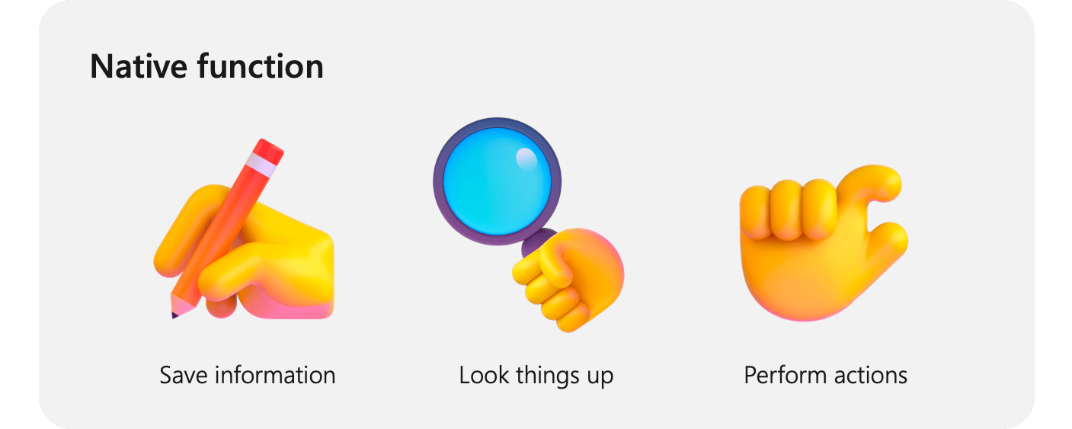
Native functions

Slide 15
Why native functions
What large-language models can’t DO?
Retrieve data from external data sources
Knowing what time it is
Performing complex math
Completing tasks in the real world
Memorizing and recalling information

Slide 16
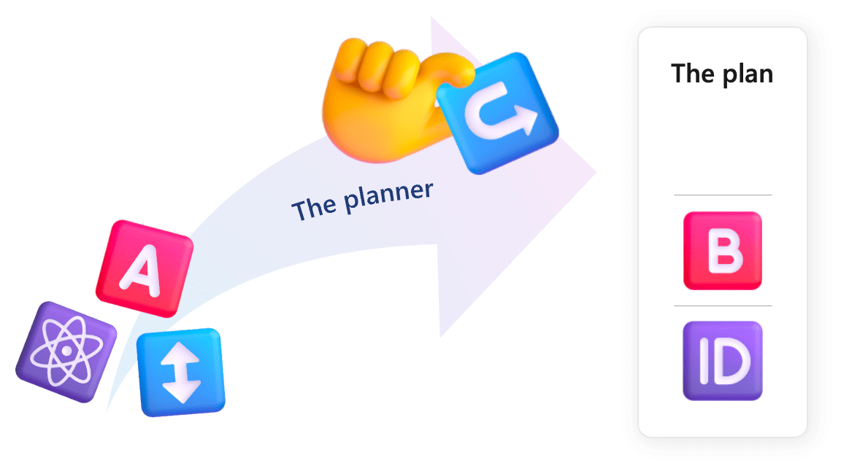
Automation with planner
Build a plan on how to complete the request
Automatically orchestrate the functions
Developer only provides the plugins & functions, the rest will be served by the planner
Combine functions in ways that you may not have thought of

Slide 17
So, in general, it looks like
Semantic Kernel
Planner (optional)
Input
Output
Plugins
Plugins
Semantic functions
LLMs
gpt3.5-turbo
gpt4, gpt4-turbo
Native functions
REST API
Database
Searching
Calculation

Slide 18
Prompt flow + Semantic kernel
Notes:
Quick Start — Prompt flow documentation (microsoft.github.io)
Quick Start — Prompt flow documentation (microsoft.github.io)

Slide 19
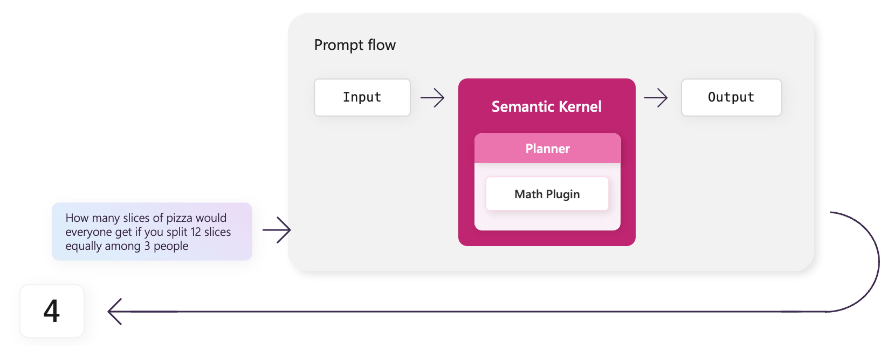
Semantic Kernel + Prompt flow
Notes:
Quick Start — Prompt flow documentation (microsoft.github.io)
Quick Start — Prompt flow documentation (microsoft.github.io)

Slide 20
Demo

Slide 21






LLM techniques
Chat with enterprise data
Prompting engineering
prompt input
Vector
Database
Language
apps
OpenAI
LLMs
SharePoint
Chat bot
apps
prompt output
Confluence
Prompt format
Set the context
Instruction
Clear output format
OpenAI
LLMs
Document
sources
Approaches to connect with enterprise data
Retrieval augmented generation (RAG) through a vector database.
Fine-tune (OpenAI supports fine-tuning for the model gpt-turbo-35)
Fine-tune open models using LoRA / QLoRA
Prompt techniques
Zero-shot, one-shot, few-shot, …
Chain of thought
Tree of thought

Slide 22



Security & data privacy
Secured Infra + App
Secured LLM Models
Secured prompting
Authentication with Azure AD (with 2-factor authentication)
Support OAuth2.0 + OpenID connect
Authorization with RBAC-enabled (fine-grained permissions)
Keys are protected with Azure KeyVault
LLM models are securely deployed on Azure OpenAI service with separated endpoint + key.
Secured virtual network with private endpoint support for Azure OpenAI service
No sensitive data is exposed to Internet or served for model training.
Content filtering enabled to reduce risk of harmful use
Follow OWASP top-10 for LLMs such as prompt injection, insecure output handling, sensitive info exposure, …
Apply best prompting design patterns to ensure expected output and allow to get user feedbacks.

Slide 23
Technology to build LLM-powered apps
Front-end
Back-end
Generative AI
JavaScript / TypeScript
ReactJS
TailwindCSS
Figma (for prototyping)
.NET SDK
ASP.NET Core
Integration with:
SharePoint
Azure DevOps
Azure Power Automate
Azure Container Apps
Azure Static Apps
Azure ComosDB
Integrate with AzureAD
OpenAI / Azure OpenAI
gpt-turbo-35
gpt-turbo-35-16k
ada-embedding-002
Prompt Engineering
Vector database with Azure Cognitive Search
Semantic Kernel
Model fine-tuning

Slide 24
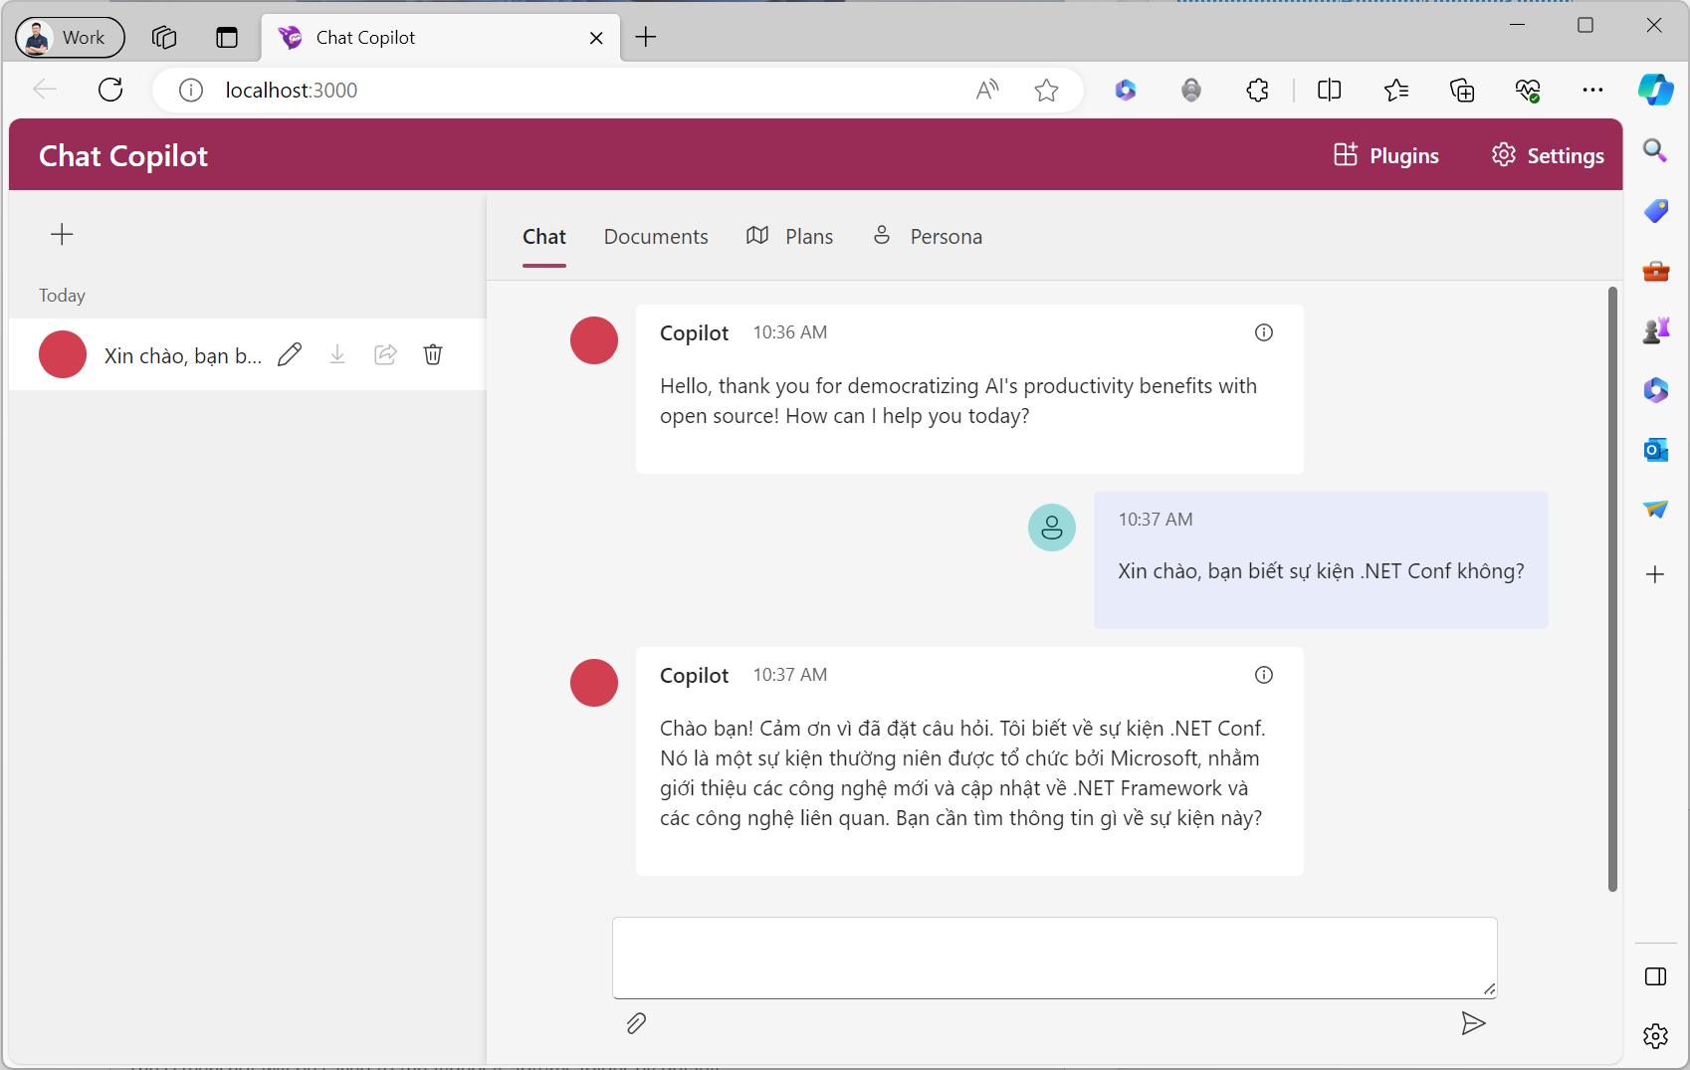

Slide 25
Demo
Copilot chat

Slide 26
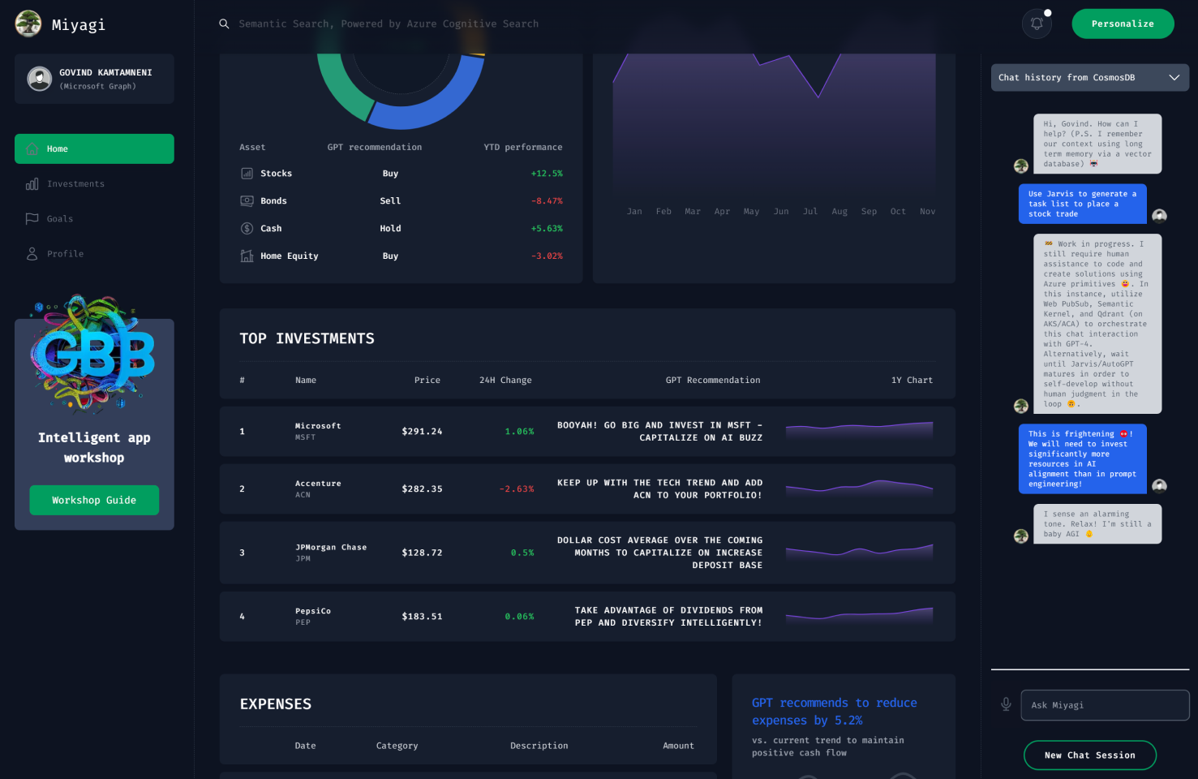
May you want to discover more?
Deep diving to this PROJECT…
Project Miyagi
Sample to envision intelligent apps with Microsoft's Copilot stack for AI-infused product experiences.

Slide 27
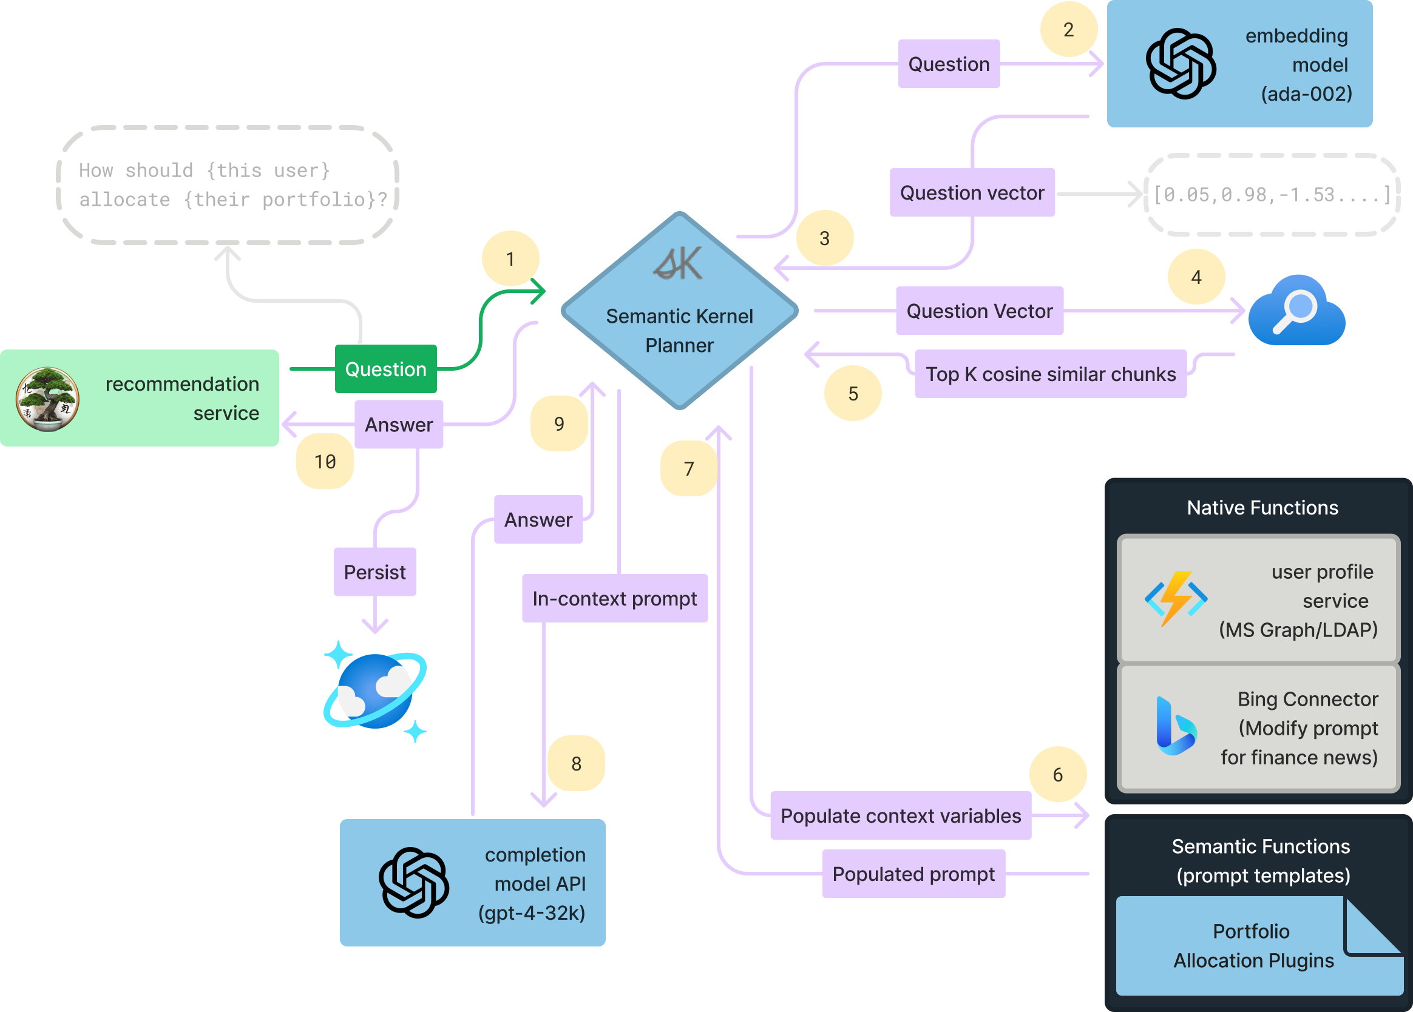
May you want to discover more?
Deep diving to this PROJECT…
Project Miyagi
Sample to envision intelligent apps with Microsoft's Copilot stack for AI-infused product experiences.

Slide 28
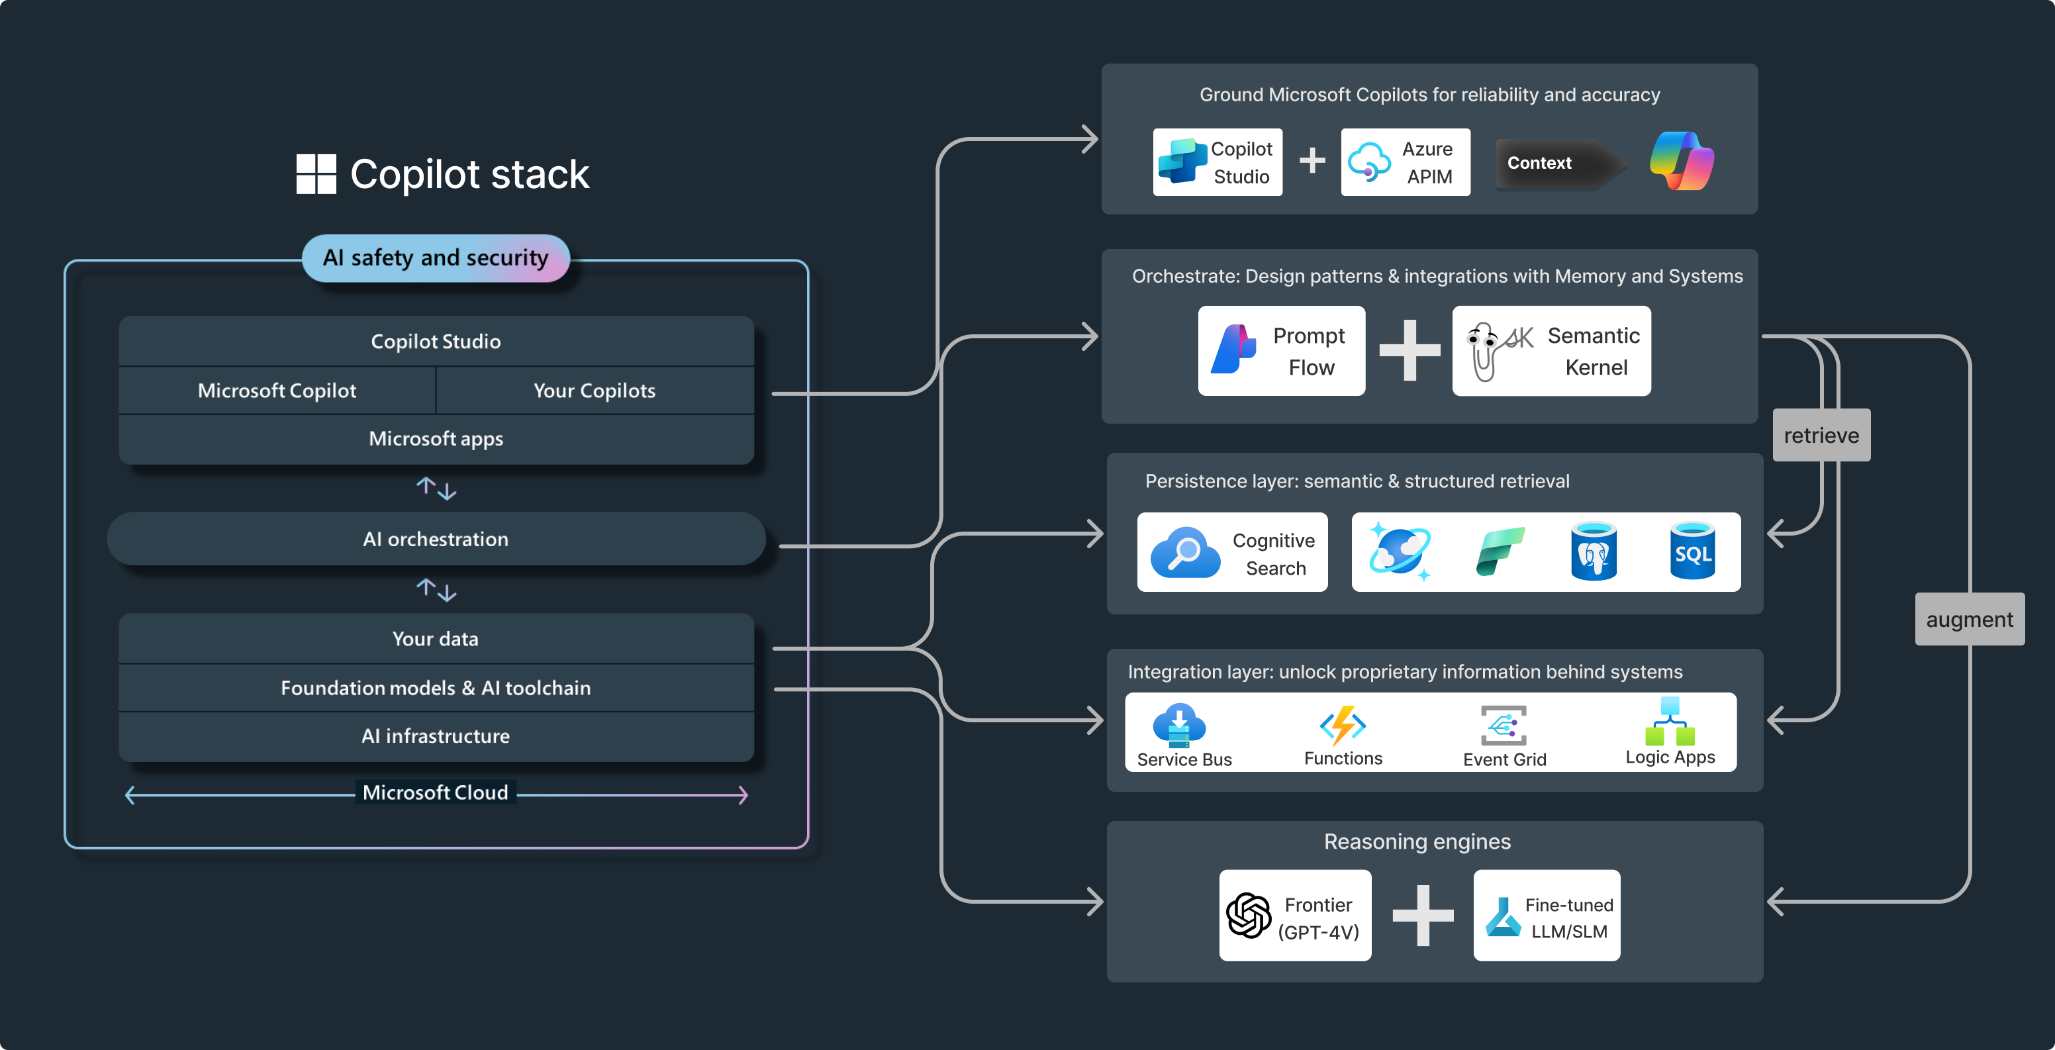
Copilot stack

Slide 29
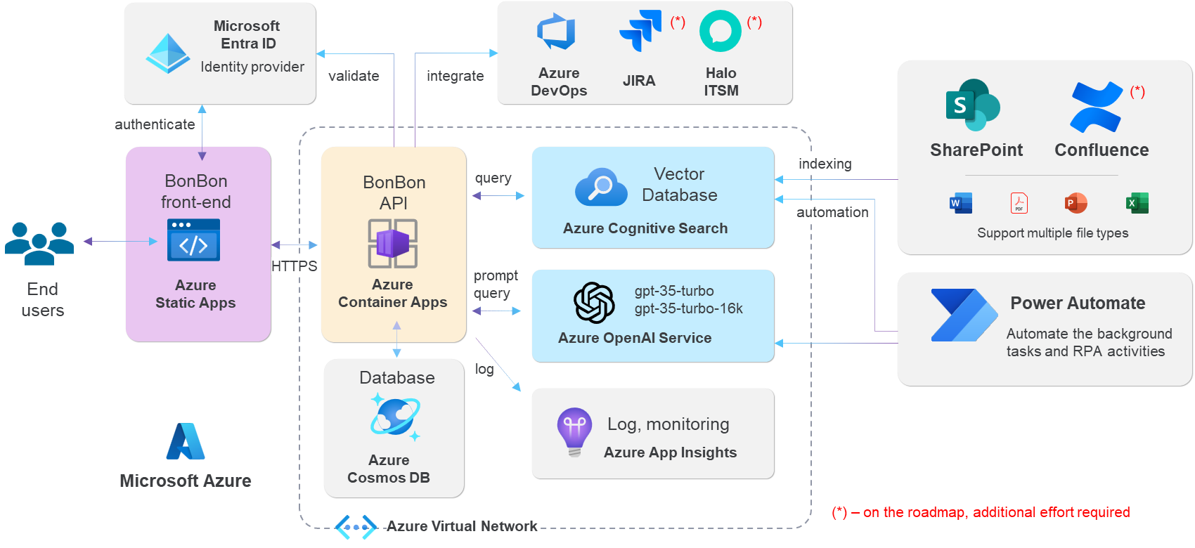
Reference GenAI architecture

Slide 30
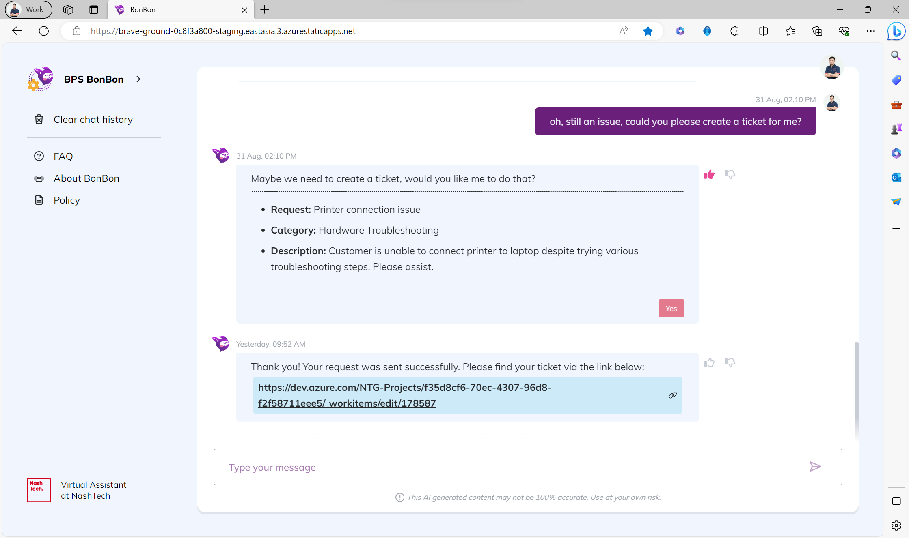
Bonbon virtual assistant

Slide 31
Key take-aways
A quick glimpse on Generative AI
Microsoft Generative AI landscape
A quick view on Semantic Kernel
A quick hand-on how Semantic Kernel works
Now you know why Microsoft & .NET loves AI

Slide 32
References
Semantic kernel microsoft/semantic-kernel: Integrate cutting-edge LLM technology quickly and easily into your apps (github.com) semantic-kernel-docs/samples/dotnet at main · MicrosoftDocs/semantic-kernel-docs (github.com)
Langchain framework langchain-ai/langchain: ⚡ Building applications with LLMs through composability ⚡ (github.com)
Prompt engineering Prompt Engineering Guide | Prompt Engineering Guide (promptingguide.ai)
Teams AI Library microsoft/teams-ai: SDK focused on building AI based applications and extensions for Microsoft Teams. (github.com)
Prompt flow Flows — Prompt flow documentation (microsoft.github.io)
Useful links for you

Slide 33
Download .NET 8
https://aka.ms/get-dotnet-8

Slide 34
Questions and answers

Slide 35
Thank you

